Slide 1
MICRO-CREDIT DEFAULTER PROJECT
SUBMITTED BY,
HARESH KHARSEL

Slide 2
CONTENTS
INTRODUCTION
BUSINESS PROBLEM FRAMING
DATA SOURCES AND THEIR FORMATS
DATA LOADING AND THE DESCRIPTION OF DATA
DATA PRE-PROCESSING
VISUALIZATIONS
INTERPRETATION OF RESULTS
MODEL/S DEVELOPMENT AND EVALUATION
CONCLUSION

Slide 3
INTRODUCTION
A Microfinance Institution (MFI) is an organization that offers financial services to low-income populations. MFS becomes very useful when targeting especially the unbanked poor families living in remote areas with not much sources of income. The Microfinance services (MFS) provided by MFI are Group Loans, Agricultural Loans, Individual Business Loans and so on.
Many microfinance institutions (MFI), experts and donors are supporting the idea of using mobile financial services (MFS) which they feel are more convenient and efficient, and cost saving, than the traditional high-touch model used since long for the purpose of delivering microfinance services. Though, the MFI industry is primarily focusing on low-income families and are very useful in such areas, the implementation of MFS has been uneven with both significant challenges and successes.
Today, microfinance is widely accepted as a poverty-reduction tool, representing $70 billion in outstanding loans and a global outreach of 200 million clients.

Slide 4
BUSINESS PROBLEM FRAMING
We are working with one such client that is in Telecom Industry. They are a fixed wireless telecommunications network provider. They have launched various products and have developed its business and organization based on the budget operator model, offering better products at Lower Prices to all value conscious customers through a strategy of disruptive innovation that focuses on the subscriber.
They are collaborating with an MFI to provide micro-credit on mobile balances to be paid back in 5 days. The Consumer is believed to be defaulter if he deviates from the path of paying back the loaned amount within the time duration of 5 days. For the loan amount of 5 (in Indonesian Rupiah), payback amount should be 6 (in Indonesian Rupiah), while, for the loan amount of 10 (in Indonesian Rupiah), the payback amount should be 12 (in Indonesian Rupiah).

Slide 5
DATA SOURCES AND THEIR FORMATS
The data is been provided by one of our clients from telecom industry. They are a fixed wireless telecommunications network provider and they have launched various products and have developed its business and organization based on the budget operator model, offering better products at Lower Prices to all value conscious customers through a strategy of disruptive innovation that focuses on the subscriber.
The data is been given by Indonesian telecom company and they gave it to us in a CSV file, with data description file in excel format. They also had provided the problem statement by explaining what they need from us and also the required criteria to be satisfied.

Slide 6
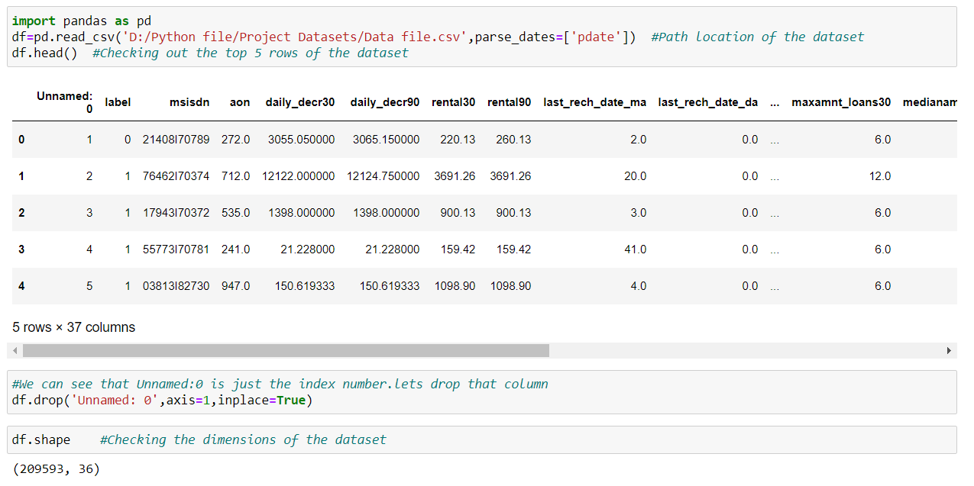
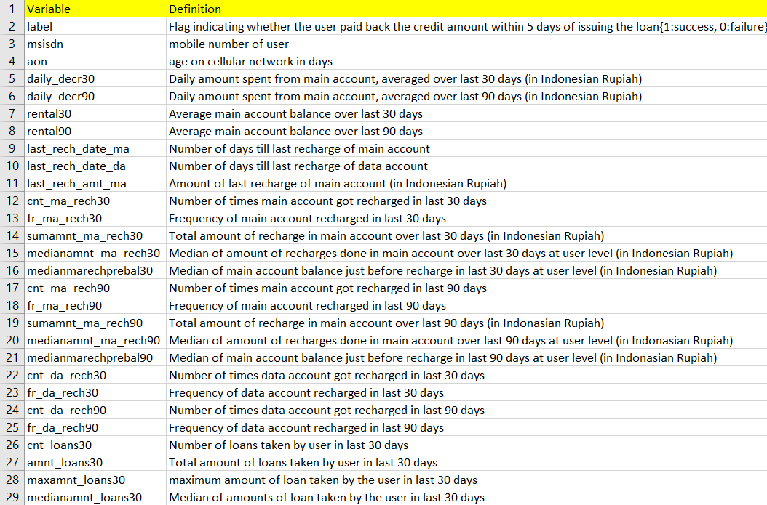
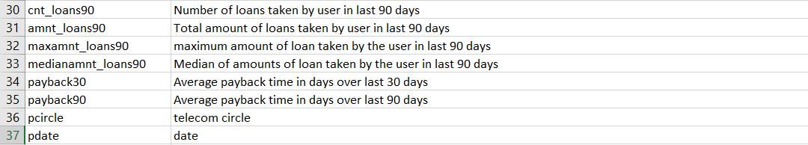
DATA LOADING AND THE DESCRIPTION OF DATA
Screenshots of the code for loading the dataset and the description of the dataset provided by the client

Slide 7
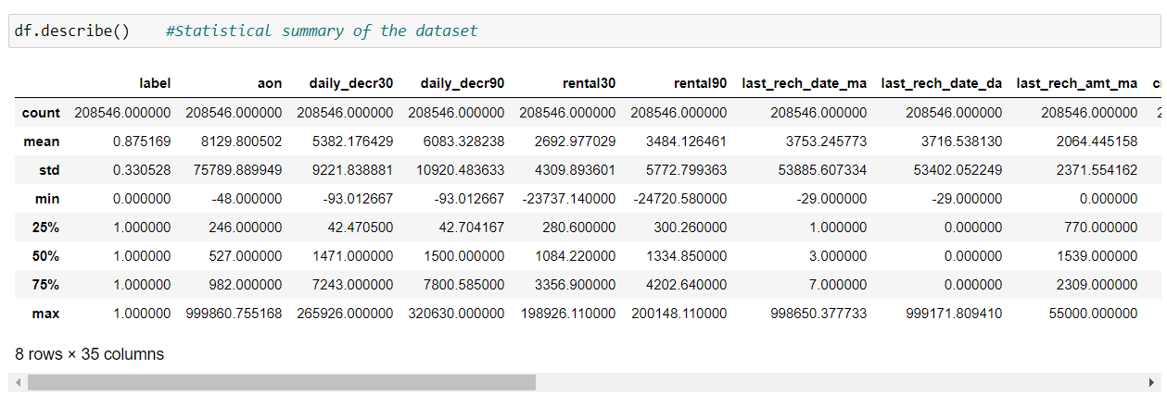
DATA PRE-PROCESSING
Checking out the statistical summary of the dataset
If we can observe above, we will see that the data is quite imbalanced. In some columns the mean is greater than median, so that we can say the data which given by our client is right skewed from the origin, and for some columns the mean is lesser than the median so I can say the data is left skewed. I also observed that there is a huge difference in 75% quartile and maximum value so from that I conclude that the data contains huge outliers, and also in some columns I have seen that there is no data till 75% quartile and eventually the maximum data come in picture so that we can just drop that columns.

Slide 8
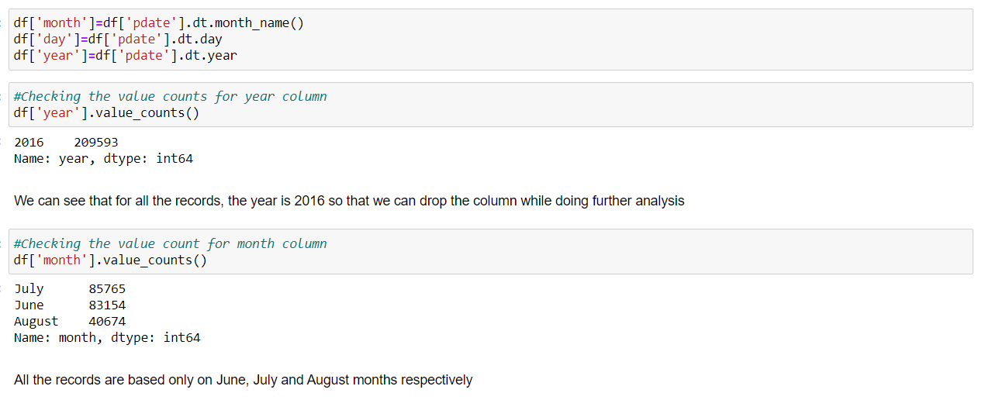
Handling the pdate column
Then I have checked the date columns and found that the data belongs to the year 2016, so what I have done is that I extracted the month and day from the date and saved the data in separate columns, and tried to visualize the data on the basis of months and days.

Slide 9
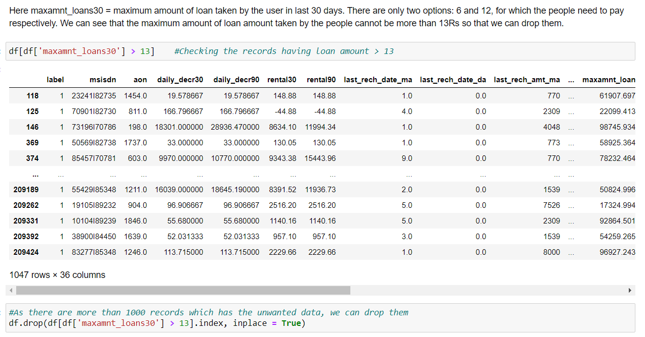
Checking the maximum amount of loan taken by people in last 30 days
I had checked the maximum amount of loan taken by the user in last 30 days and found that the data have so much of outliers as per the description given by the client that the loan amount can be paid by the customer is either rupiah 6 or 12 so that I have dropped all the loan amount that shows the loan is taken more than 12 rupiah.

Slide 10
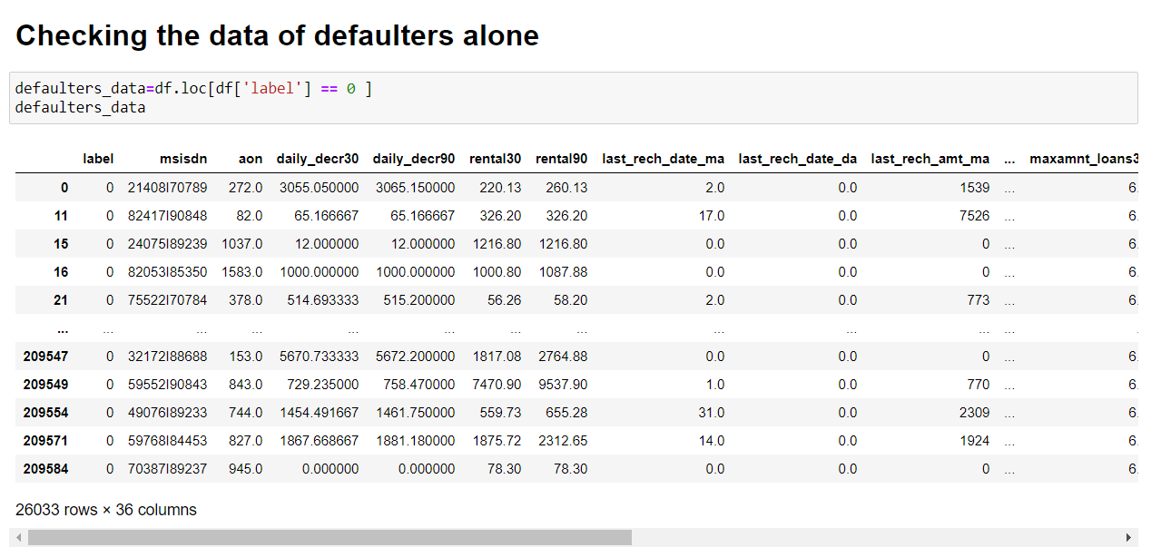
Defaulters data
Then I separated the defaulter’s data and checked the valuable customer to the network and found that their monthly revenue is more than 10000 rupiah.
Though the data is quite imbalanced and many columns doesn’t have data except the maximum value so I dropped that columns.

Slide 11
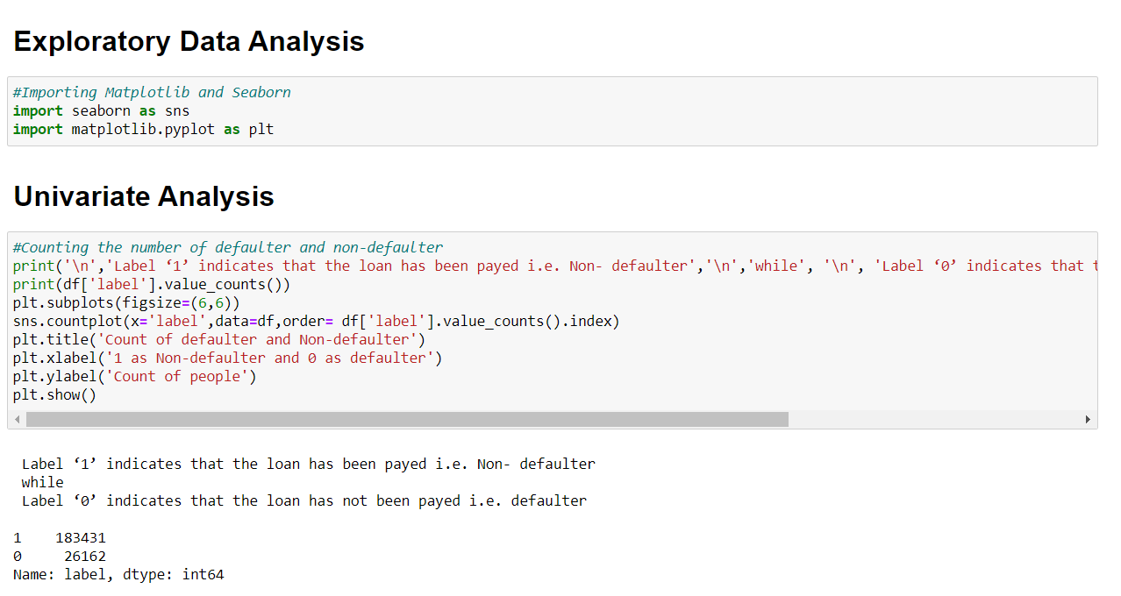
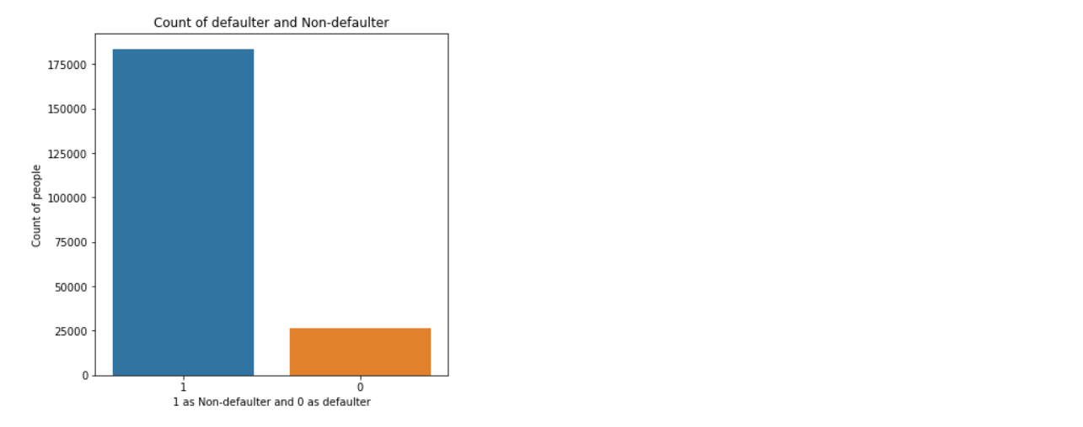
VISUALIZATIONS
Univariate Analysis
Observations:
We can see that 183431 people had paid their loan amount whereas 26162 people did not pay the amount.
Here the dataset is imbalanced. Label ‘1’ has approximately 87.5% records, while label ‘0’ has approximately 12.5% records.

Slide 12
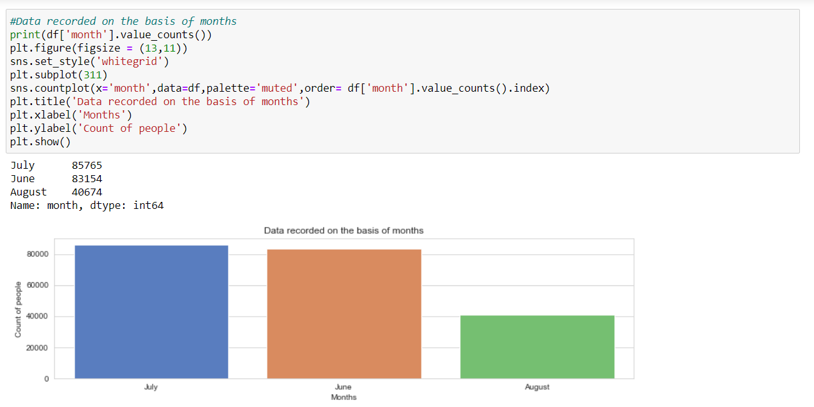
Data recorded on the basis of months
Observations:
Maximum number of people records have been recorded in the month of July with a value of 85765 whereas least number of records have been recorded in the month of August with a value of 40674.
All the records are recorded in the months of June, July and August respectively.

Slide 13
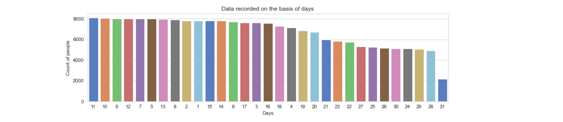
Data recorded on the basis of days
Observations:
On 11th day, maximum number of people either took the loans or repaid the loan amount. The number of people is 8092.
On 31st day, minimum number of people either took the loans or repaid the loan amount. The number of people is 2178.

Slide 14
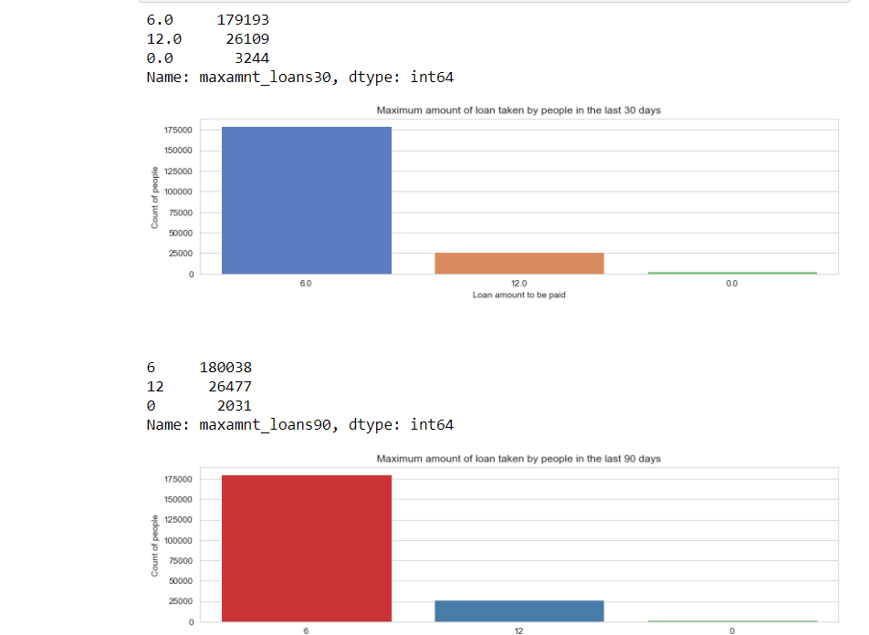
Maximum amount of loan taken by people in last 30 and 90 days
Observations:
In 30 days, maximum number of people had taken 6Rs as the loan amount and the number of people is 179193 whereas the minimum number of people had not taken loan and their number is 3244.
In 90 days, maximum number of people had taken 6Rs as the loan amount and the number of people is 180038 whereas the minimum number of people had not taken loan and their number is 2031.
Maximum number of people had taken 12Rs as the loan amount within 90 days and their number is 26477 whereas for 30 days the number of people who had taken 12Rs is 26109 respectively.

Slide 15
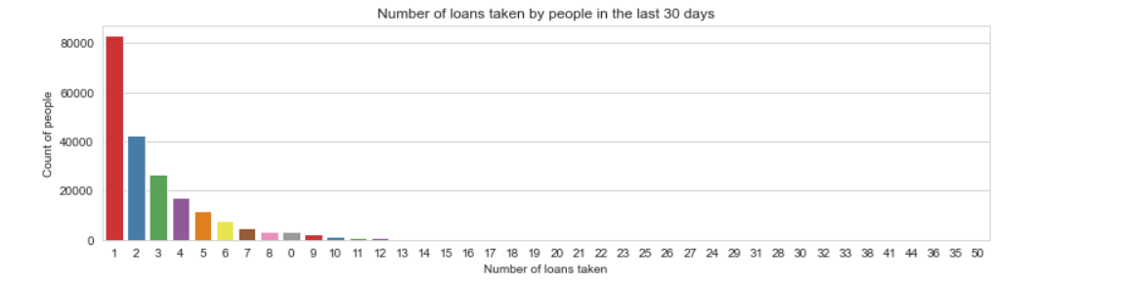
Number of loans taken by people in last 30 days
Observations:
83028 is the maximum number of people who had taken loans and they had taken only once.
Single person had taken loans for 41, 50, 36 times etc.

Slide 16
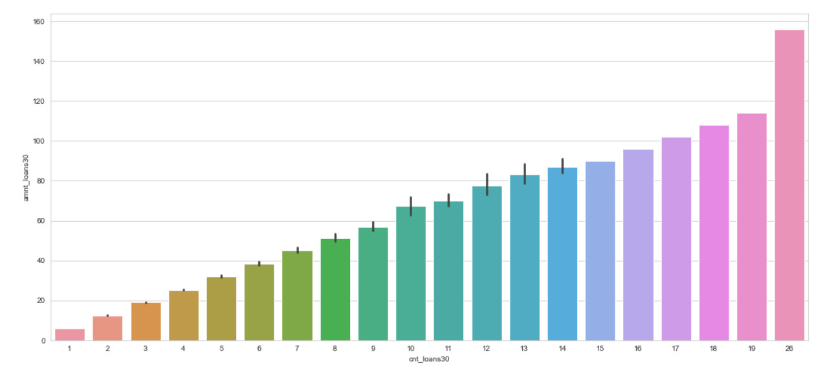
Number of loans taken by people in last 90 days vs Amount of loan taken by the people in last 90 days (considering only defaulters)
Observations:
Maximum number of times the loan taken by the people is 26 and the amount is equivalent to 15.
Minimum number of times the loan taken by the people is 1 and the amount is equivalent to 6.

Slide 17
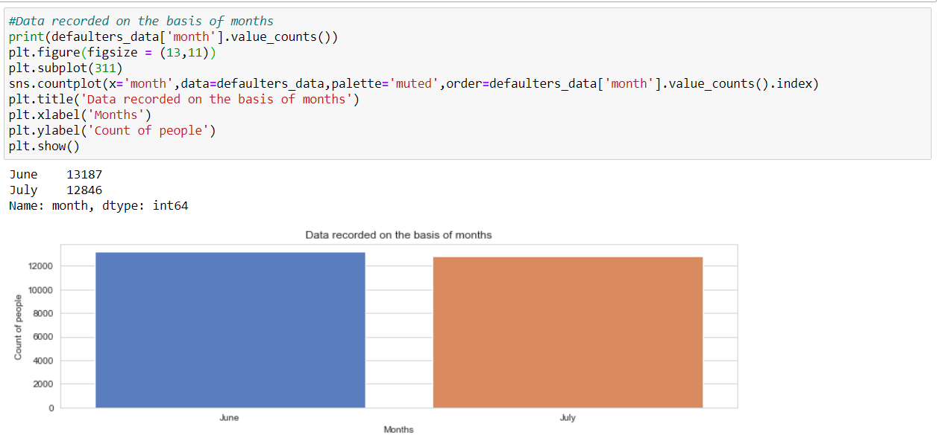
Defaulters data recorded on the basis of months
Observations:
The records had been available in the months of June and July, whereas there are no records in August.
Maximum number of records are available in June with a value of 13187.

Slide 18
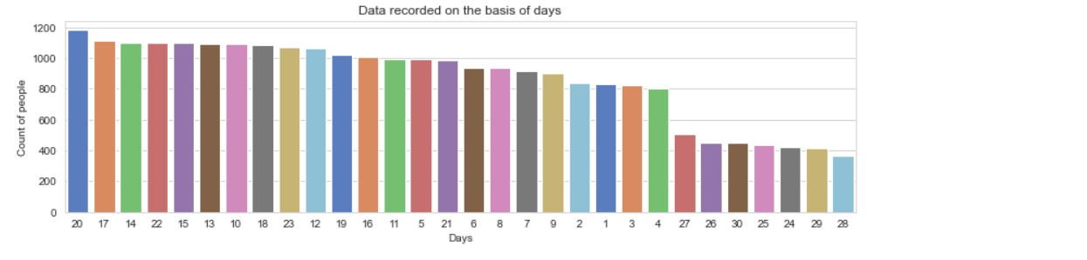
Defaulters data recorded on the basis of days
Observations:
On 20th day the maximum number of records are there and the value is 1182.
On 28th day, the minimum number of records are there and the value is 363.

Slide 19
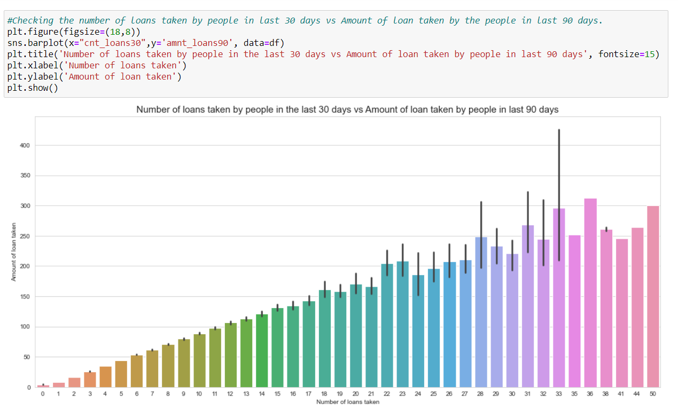
Bivariate Analysis
Number of loans taken by people in last 30 days vs Amount of loan taken by the people in last 90 days
Observations:
Maximum number of loans taken by the people is 36 and the amount is equivalent to 320.
Minimum number of loans taken by the people is 0.

Slide 20
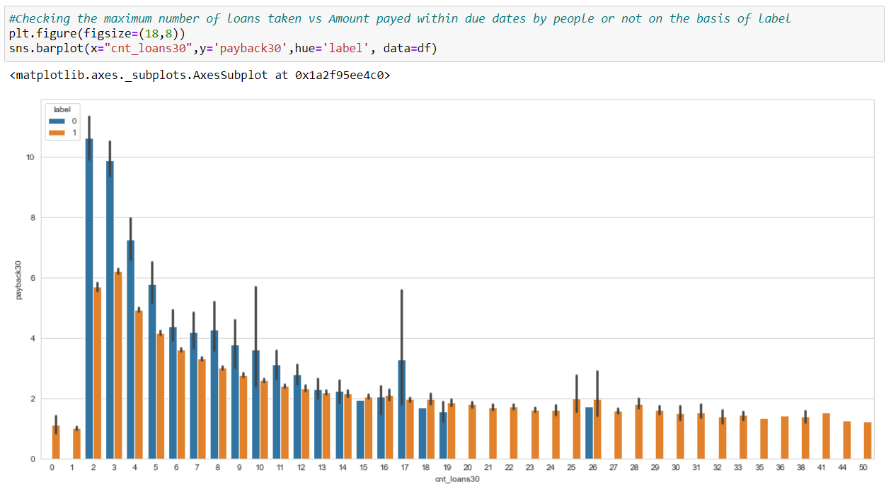
Maximum number of loans taken vs Amount paid within due dates by people or not on the basis of label
Observations:
We can observe that the Average payback time over last 30 days is higher for people who had taken 2 times the loan and say that the users with a smaller number of loans taking are more than the defaulters.

Slide 21
INTERPRETATION OF RESULTS
Visualization
The data set is quite imbalanced and there is lot of work to do before going to explore in depth with this dataset.
As per the client, they want us to predict whether the loan amount has been paying by users in 5 days or not.
As this dataset belongs from the year 2016, the datas are recorded in the month of June, July and August. From the visualization, I am able to say that the most loan amount taken is rupiah 6 and most of the users are paying the loan within the time frame of 5 days, but many early users failed to do so. They usually take almost 7 to 8 days to pay the loan amount and even the valuable customers some time fails to pay the amount within the time frame.
I would suggest the client to increase the payment duration to 7 days, although they want from us to predict the amount within 5 days.
One more thing I noticed that, the smaller number of loans taken by the people are more defaulters and the frequently loan taking customers are less defaulters.

Slide 22
Most importantly, the people are paying the amount early or lately and sometimes they might fail to pay within the time frame, but I observed that almost 80% of users are paying the amount within 7-8 days.
There are no null values in the dataset.
Label 1 has approximately 87% records, and label 0 have 13 % records which is purely imbalanced.
maxamnt_loans90 columns gives information about customers with no loan history.
msisdn features some values are duplicated which might not be realistic. So, we have dropped the row which does not contain realistic value.
The collected data is only for one Telecom circle area as per Dataset Documentation so that we had dropped that column.

Slide 23
Correlation Analysis
Here, we check how the different independent features are corelated with each other and their strength of Relationship, weather they are positively correlated or negatively corelated.
The value of Correlation ranges from -1 to +1. -1 indicate the negative correlation with increase in one independent variable the dependent variable decreases +1 indicates the positive correlation means with increase in independent variable dependent variable also increase.
In our case, some of the independent features are highly corelated with each other with a person corelation strength more than 0.9 hence we have to dropped all the features which are highly multicollinear to avoid multicollinearity.
month column is highly negative correlated with the target variable with a highest value of -54%.
98% is the highest positive correlated value.

Slide 24
Checking for skewness
Skewed data are not normally distributed; either they are positive skewed or negative skewed. If the data is skewed, it impacts on the accuracy of the model. So, it’s very important to remove the skewness for right and left skewed data by using transform methods like square and cube root, boxcox and logarithm transformation.
For visualization, we use distplot to check the distribution of data points and the shape of the curve. Any value greater than 0.55 or less than -0.55 is considered to be skewed data.
In our case, most of the data are skewed and hence we have to remove the skewness during Scaling because if we remove the skewness by log or boxcox method it will induce nan values. Sometimes while using root transforms, it can cause to form nan values. It is better to remove those values before scaling because it will show ValueError while running the code.

Slide 25
Checking for outliers
Outliers are the data points that differ significantly from other observations. Any data points greater than +3 and -3 standard deviations are called as outliers.
Z-score is the automated method used for handling outliers and it’s important to remove outliers as it impacts on the Accuracy of the Model.
In our case, each and every information is important to us and we can’t afford to lose 7-8% of data. But during the outlier’s analysis, we found that we are losing nearly 22% of data and hence we have decided not to use the outliers removed data, but using the original data itself.
Nearly 40000+ rows of data had been lost after the removal of outliers. We can visualize the presence of outliers by using boxplots.

Slide 26
Splitting of data
The data is divided into two parts using component splitting.
In this experiment, data is split based on a ratio of 80:20 for the training set and the testing set.
The training set data is used in the logistic regression component for model training, while the testing set data is used in the prediction component.
We reduce the dimensions of the dataset to 10 features by using a technique known as Principal Component Analysis, as there are nearly 35 features present.

Slide 27
Standardization
Standardization of data is done by using Standard Scaler.
Standard scaler is used to bring the data points to standard Normal Distribution having mean = 0 and SD +- 1 to enhance accuracy of the model. In our case, its most important due to presence of high skewed data and Outliers.

Slide 28
MODEL/S DEVELOPMENT AND EVALUATION
Hardware and Software Requirements and Tools Used
For doing this project, the hardware used is a laptop with high end specifications and a stable internet connection. While coming to the software part, I had used anaconda navigator and in that I have used Jupyter Notebook to do my python programming and analysis.
For using a csv file, Microsoft Excel is needed. In Jupyter Notebook, I had used lots of python libraries to carry out this project and I have mentioned below with proper justification:
1. Pandas- a library which is used to read the data, visualisation and analysis of data.
2. NumPy- used for working with array and various mathematical techniques.
3. Seaborn- visualization tool for plotting different types of plot.
4. Matplotlib- It provides an object-oriented API for embedding plots into applications.
5. zscore- technique to remove outliers.
6. skew ()- to treat skewed data using various transformation like sqrt, log, cube, boxcox, etc.
7. PCA- I used this to reduce the data dimensions to 10 columns.
8. standard scaler- I used this to scale my data before sending it to model.
9. train_test_split- to split the test and train data.
10. Then I used different classification algorithms to find out the best model for predictions.
11. joblib- library used to save the model in either pickle or obj file.

Slide 29
Testing of Identified Approaches (Algorithms)
We used the following algorithms mentioned below:
Logistic Regression
GaussianNB
Decision Tree Classifier
KNeighbors Classifier
Random Forest Classifier
Adaboost Classifier
Gradient Boosting Classifier

Slide 30
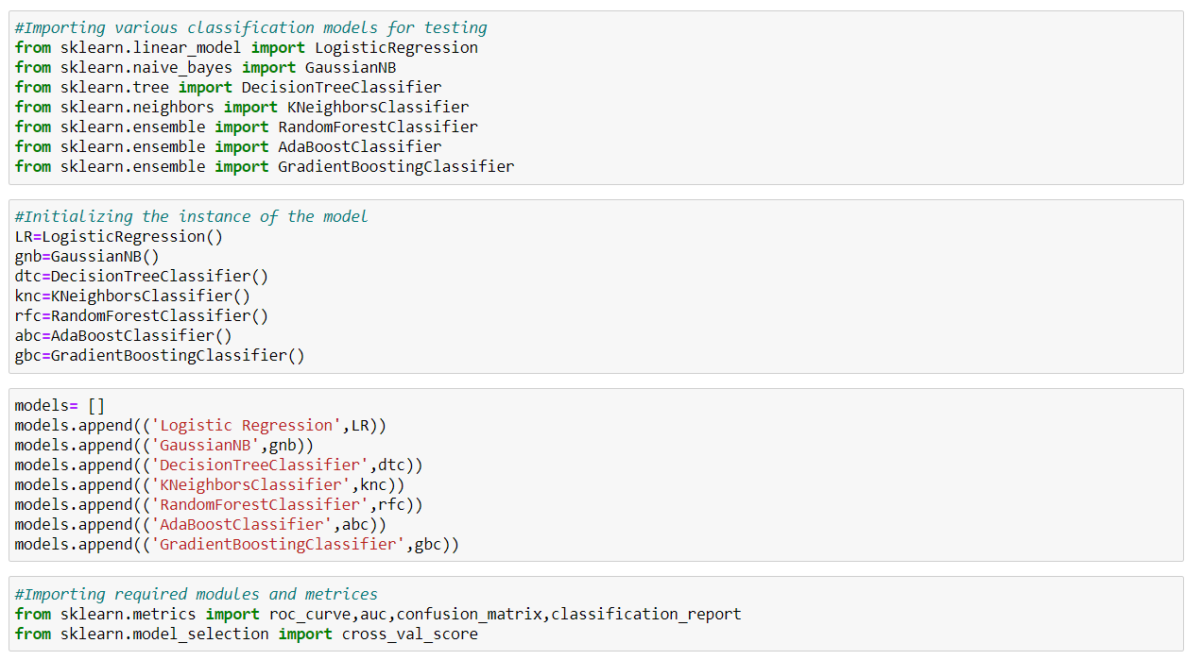
Run and Evaluate selected models
The algorithms I have used to study this research are listed above and I have attached the code below for showing how I ran these algorithms:
As you can see , I had called the algorithms, then I called the empty list with the name models [ ], and calling all the model one by one and storing the result in that.
We can observe that I imported the metrics to find the accuracy score, roc_auc_curve, auc, confusion_matrix and classification_report in order to interpret the model’s output. Then I also selected the model to find the cross_validation_score value.

Slide 31
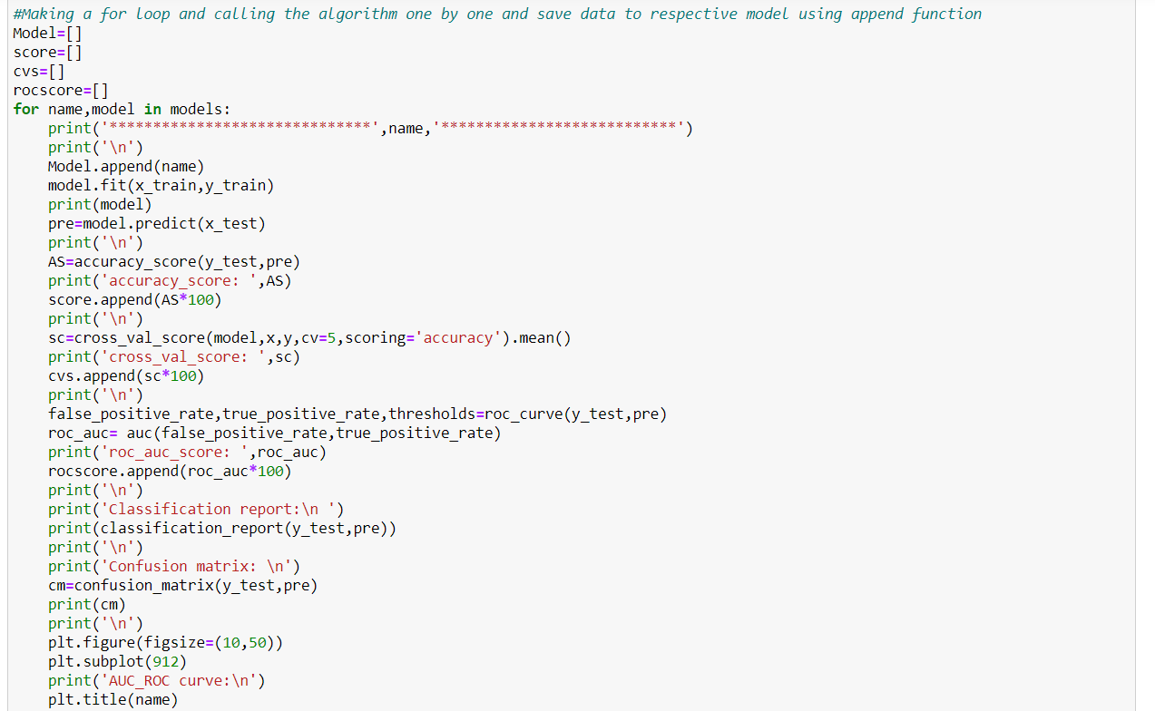
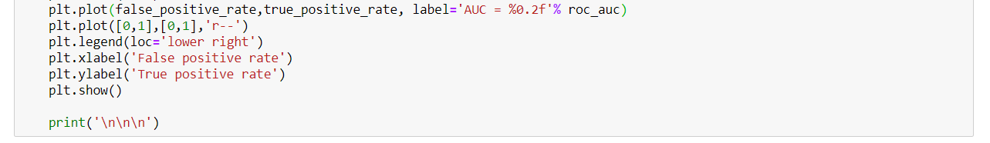
As you can observe, I made a for loop and called all the algorithms one by one and appending their result to models. The same I had done to store roc_auc_curve, auc score, and cross validation score. Let me show the output so that we can glance the result in more appropriate way.

Slide 32
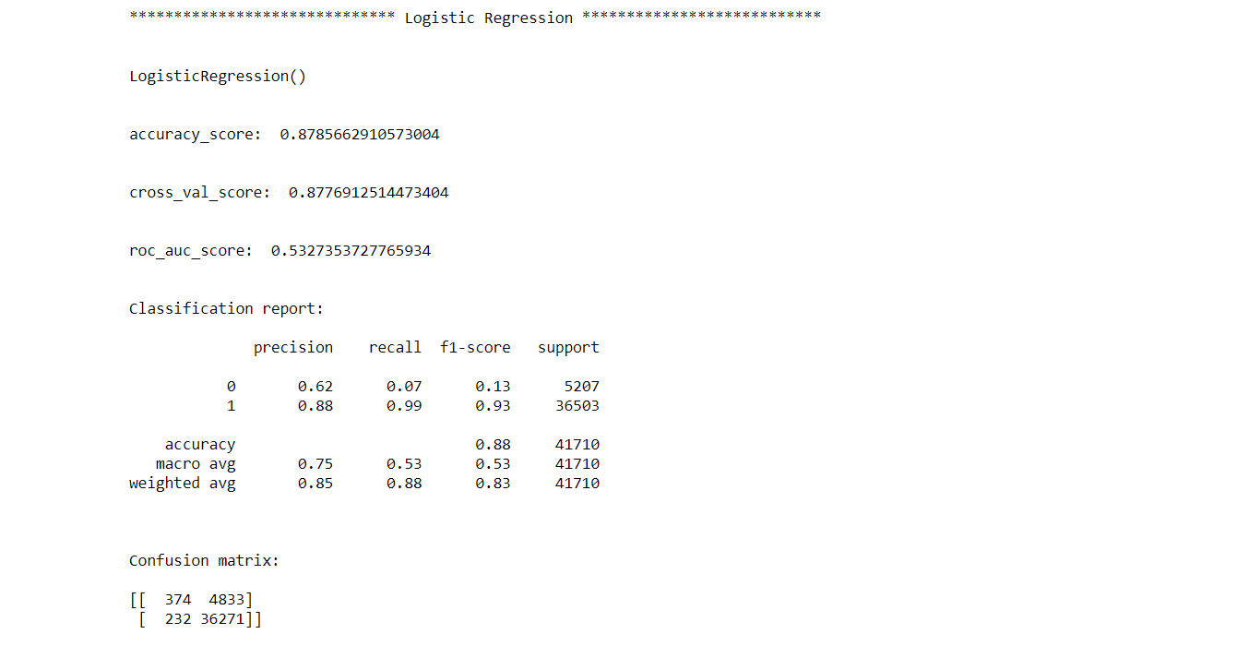
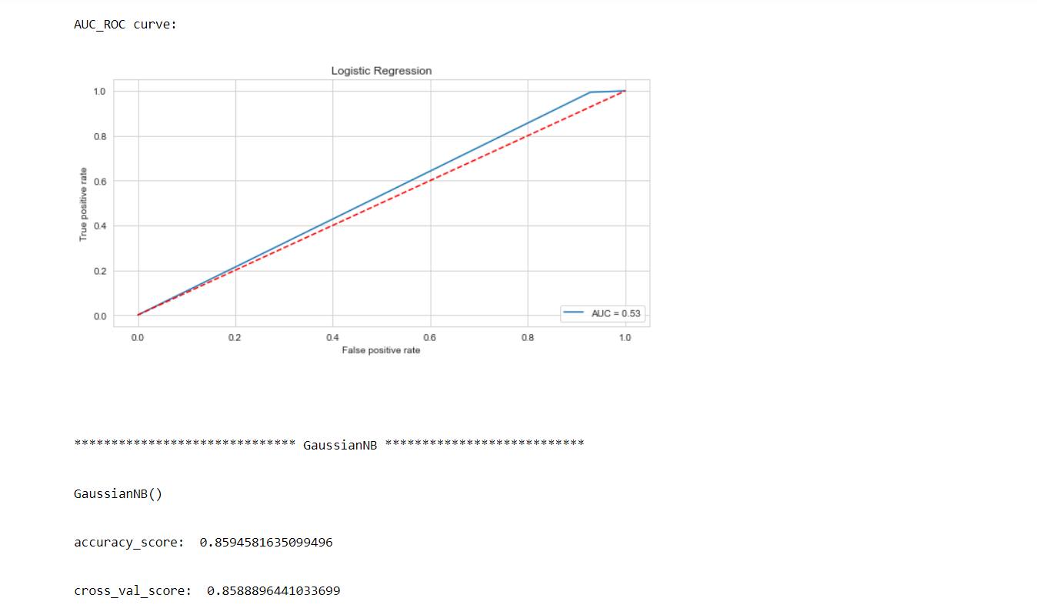
Outputs of all algorithms obtained

Slide 33
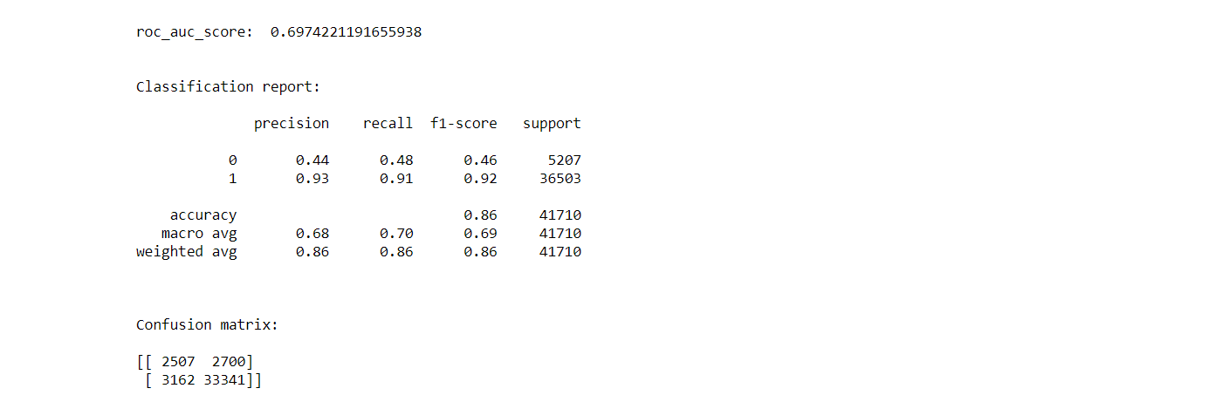
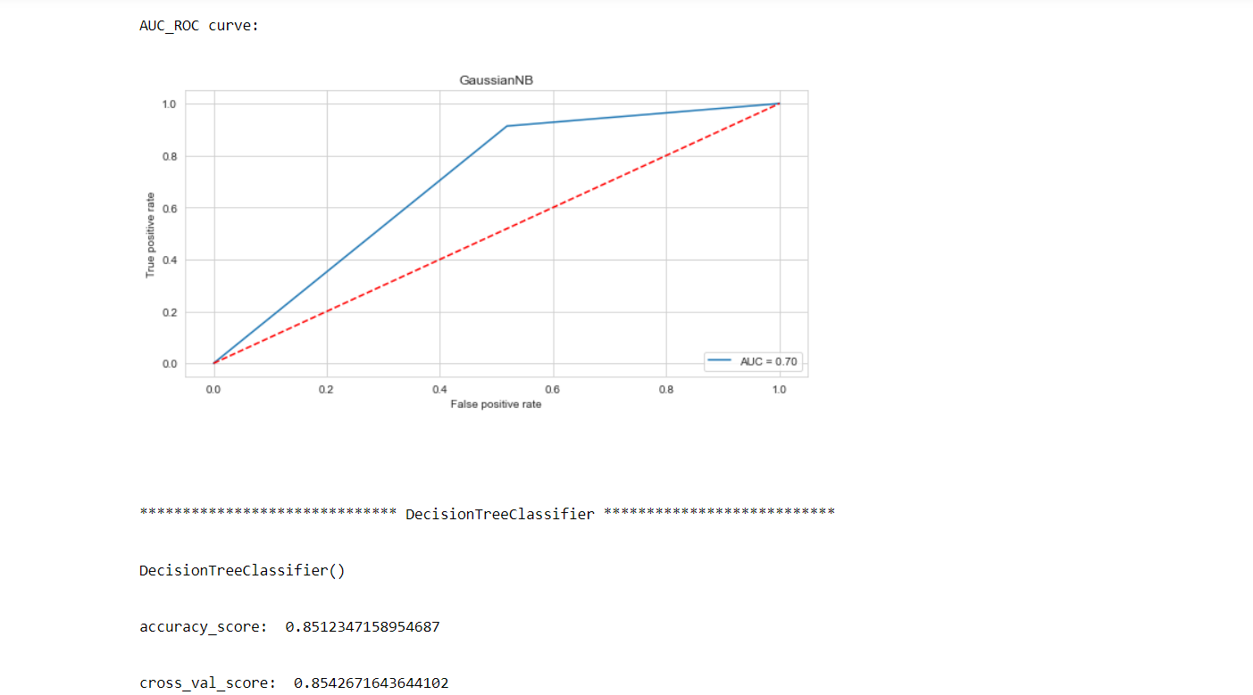

Slide 34
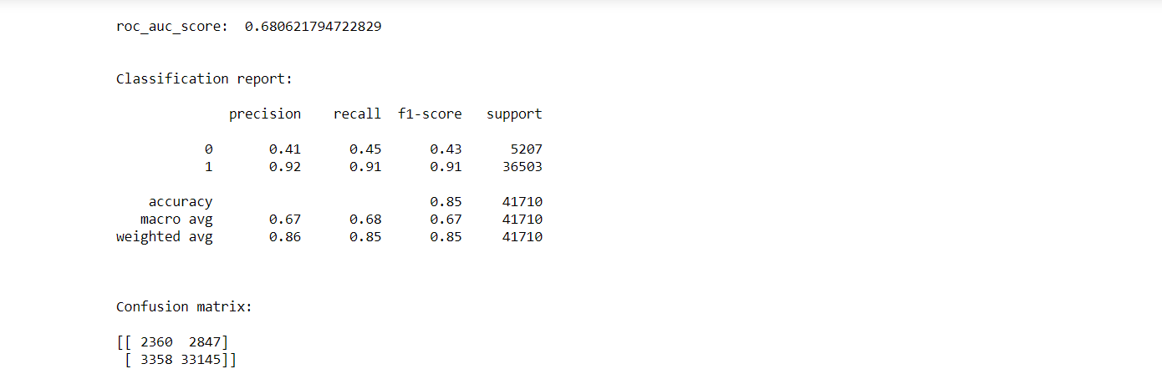
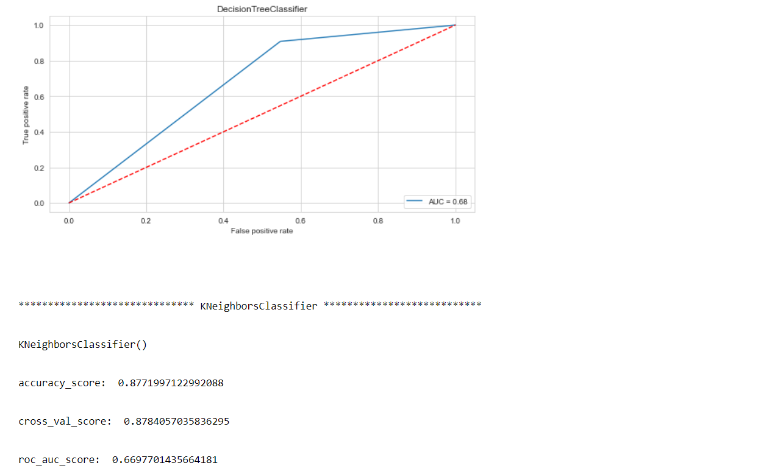

Slide 35
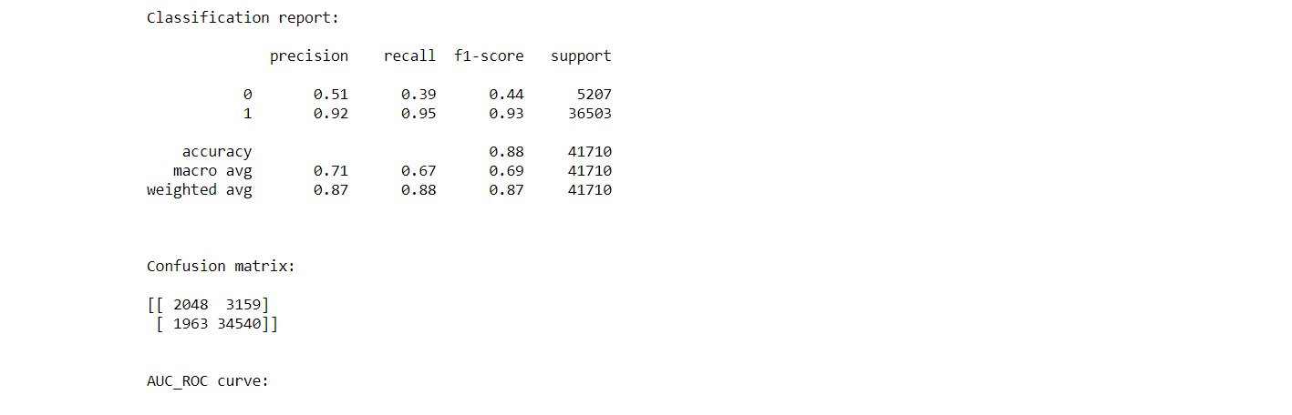
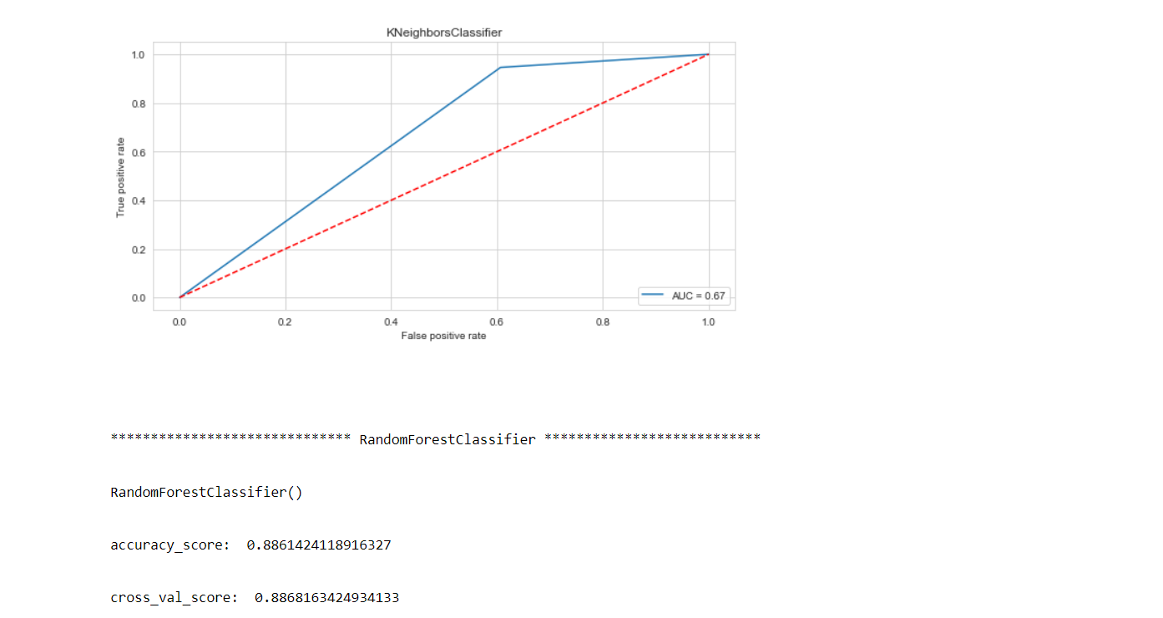

Slide 36
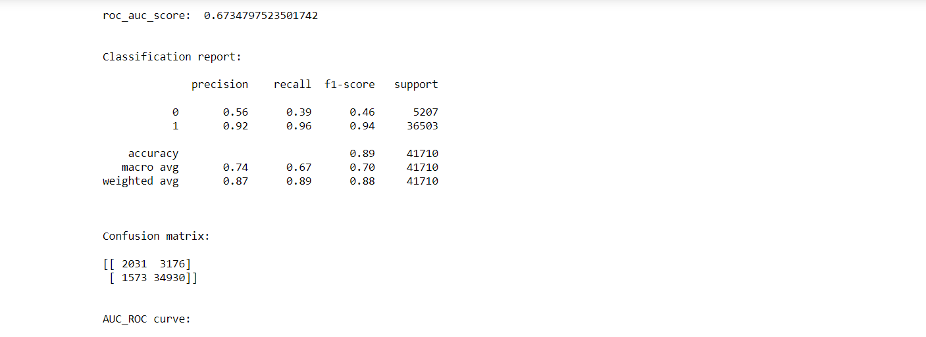
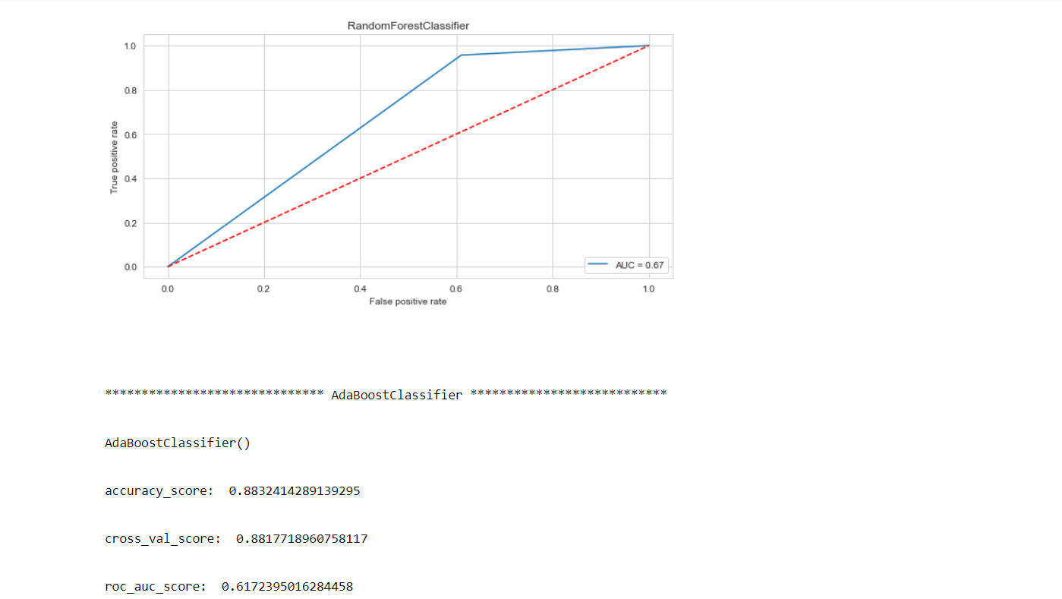

Slide 37
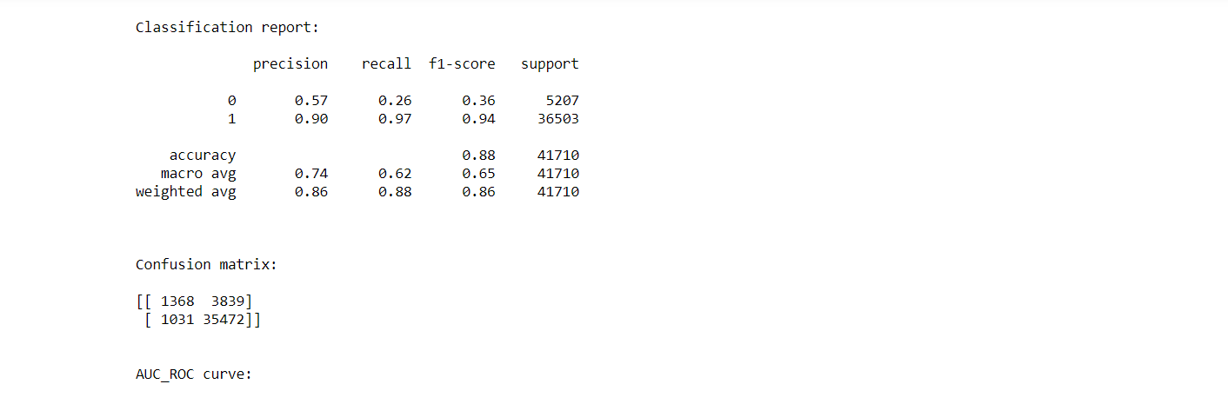
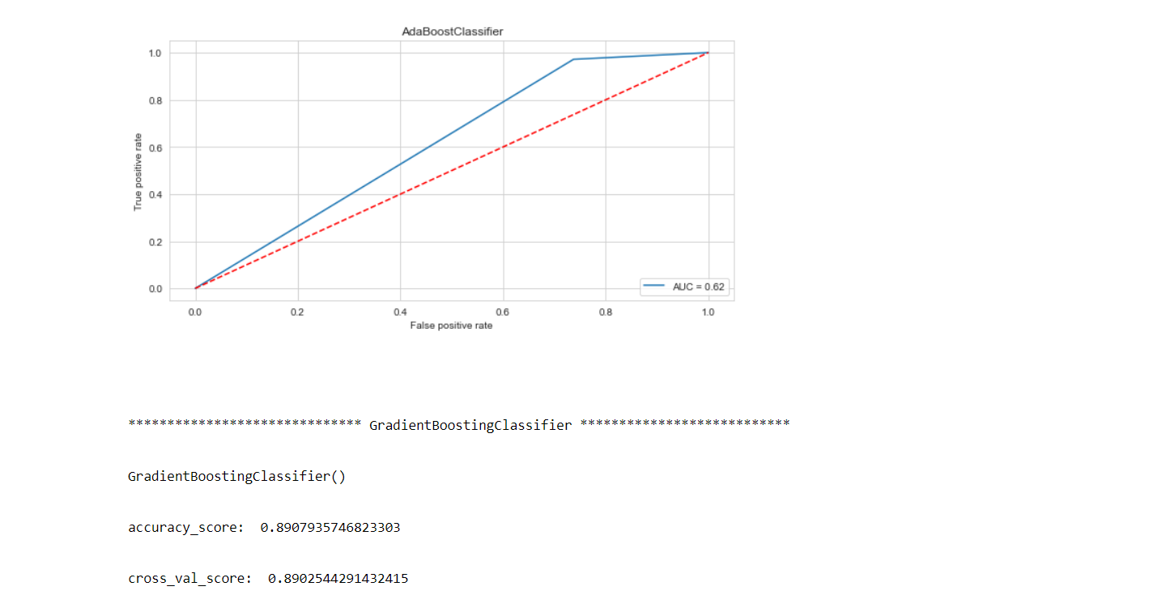

Slide 38
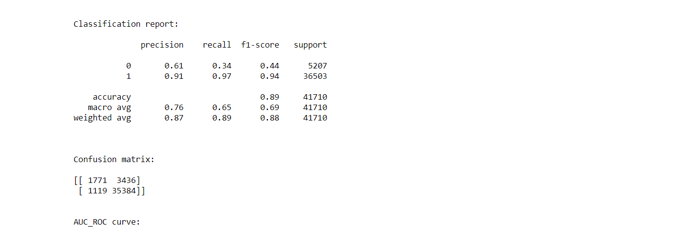
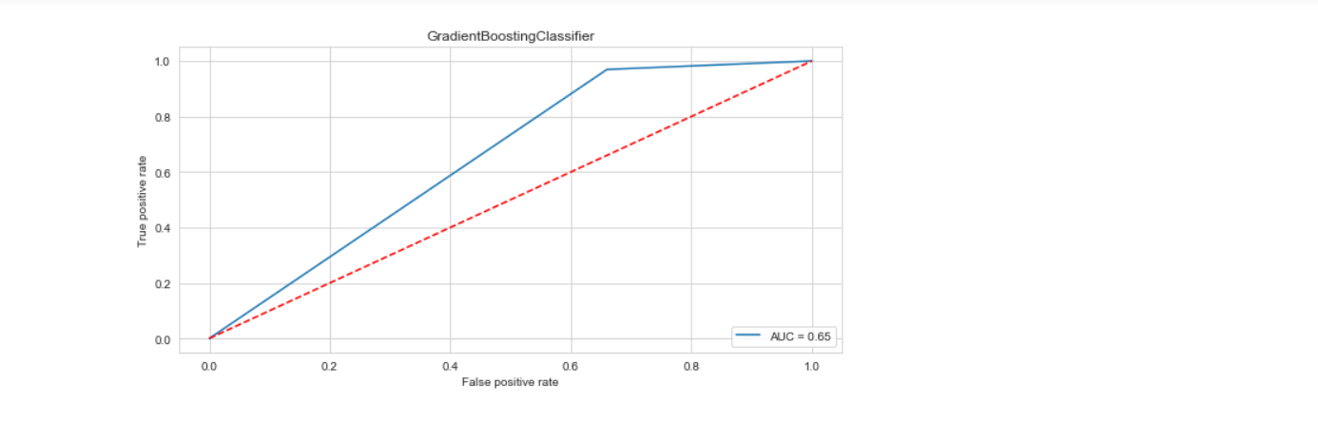

Slide 39
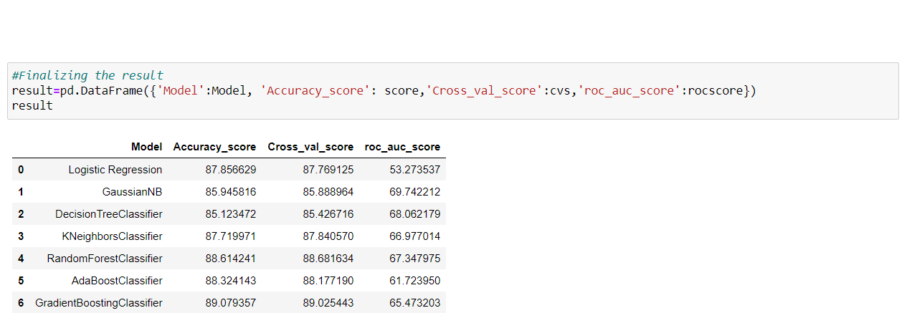
We saved the outputs obtained in a new data frame and the code is given below:
We can see that Gradient Boosting Classifier algorithm is performing well compared to other algorithms, as it is giving an accuracy score of 89.07 and cross validation score of 89.02.

Slide 40
Key Metrics for success in solving problem under consideration
Cross-validation
Confusion matrix
Classification report
AUC-ROC curve and score
Hyperparameter Tuning using GridSearchCV
After applying the Tuning, we see that our scores had been increased with the help of best parameters obtained, i.e., accuracy score from 89.07 to 89.16 and cross validation score from 89.02 to 89.13, and they are good scores too. Now, we can finalize Gradient Boosting Classifier algorithm model as the final model.

Slide 41
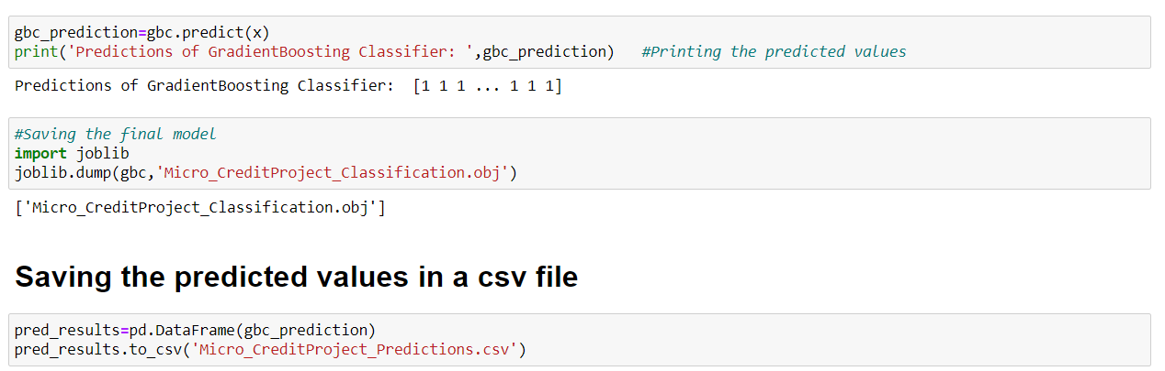
Final the model
We will final the best model obtained by saving the predictions in a separate csv file and also, we will save the model in either a pickle or obj file using joblib library.

Slide 42
CONCLUSION
After getting an insight of this dataset, we were able to understand how the people took loans and how they repaid on the basis of various factors.
First, we loaded the dataset and did the EDA process and other pre-processing techniques like skewness check and removal, handling the outliers present, filling the missing data, visualizing the distribution of data, etc.
There were some customers with no loan history and it is because the data is imbalanced such that, label ‘1’ has approximately 87.5% records, while, label ‘0’ has approximately 12.5% records.
There were many outliers present in the dataset and even though they were present, we used the original data itself as the data loss should not be more than 7-8% of data. When we checked the percentage loss after handling outliers, it was nearly 22% so that we used the original data itself with outliers in it.
Then we did the model training, building the model and finding out the best model on the basis of different metrices scores we got like ROC-AUC curve, Classification Report, Confusion matrix, etc.

Slide 43
We used algorithms like Logistic Regression, GaussianNB, DecisionTreeClassifier and KNeighborsClassifier algorithms for finding out the best model among those. We also used Ensemble Techniques like RandomForest, Adaboost and Gradient Boosting algorithms to find the best performing model.
After performing the analysis, we got Gradient Boosting Classifier algorithm as the best algorithms among all as it gave an accuracy score of 89.07 and cross_val_score of 89.02, which was highest among all. Then for finding out the best parameter and improving the scores, we performed Hyperparameter Tuning.
The problem while doing Hyperparameter Tuning is that it took nearly 2 hours to fetch the best parameters as there were nearly 2lakh records to process through and for ensemble techniques normally, tuning takes more time. For avoiding this problem, we can use other notebooks like Google Colaboratory for processing faster.
After Tuning, we saw that our scores had been increased with the help of best parameters obtained, i.e., accuracy score from 89.07 to 89.16 and cross validation score from 89.02 to 89.13, and they are good scores too.

Slide 44
We finalized the best model we obtained by saving the model in an obj file. Also, we found the predictions obtained and saved it in a new data frame.
The problems in this dataset were: High skewness, more outliers, time consumption due to a greater number of records.
Overall, we can say that it is a good dataset to predict the micro credit predictions and we can also use the finalized model for deployment process too.
We can improve the data by adding more features that are positively correlated with the target variable, having less outliers, normally distributed values, etc.

Slide 45


